Slide 1

ENCRYPTION & DECRYPTION THROUGH TRIANGULAR ENCRYPTION (TE) TECHNIQUE
Presented by
ADITYA DAS (MTECH CSE)
Roll 90/CSE No.: 230001
Under the Supervision of
Prof.(Dr.) JYOTSNA KUMAR MANDAL
DEPARTMENT OF COMPUTER SCIENCE AND ENGINEERING
UNIVERSITY OF KALYANI

Slide 2
CONTENTS
INTRODUCTION
THE SCHEME
EXAMPLE
IMPLEMENTATION
RESULT
APPLICATION WORK
CONCLUSION & FUTURE SCOPE

Slide 3
INTRODUCTION
The triangular Encryption (TE) technique, from a source block of size say n, an intermediate block of size (n-1) is generated by applying the exclusive OR(XOR) operation between each two consecutive bits. The same process is again applied to the generated block of size (n-2). The process goes on until the generation of a 1-bit block. All these block under consideration together form an equilateral triangle-like shape.

Slide 4
THE SCHEME
The plaintext to be transmitted is to be converted into a stream of bits. Since the TE technique, like all the other proposed techniques, is a bit-level technique, here also the source stream is to be decomposed into a finite number of blocks, not necessarily of the same length. To enhancement of security can be done by allowing block sizes to be different because it makes the key length large enough, hereby almost nullifying the chance of cryptanalysis to break the cipher. The entire scheme includes several parts in it. First of all is the formation of the triangle, after that choose different options that are available to form the target block from the triangle that are to be generate. The overall reverse processes for decryption to generate the source block from a target block.

Slide 5
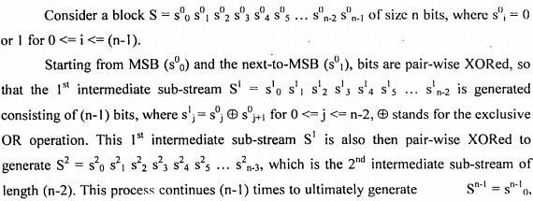
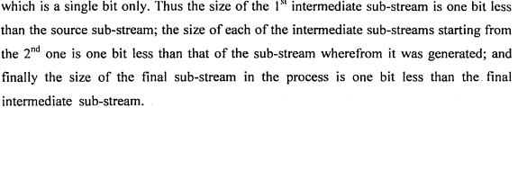
EXAMPLE

Slide 6
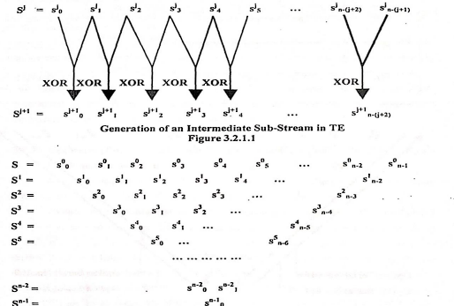
FORMATION OF TRIANGLE

Slide 7
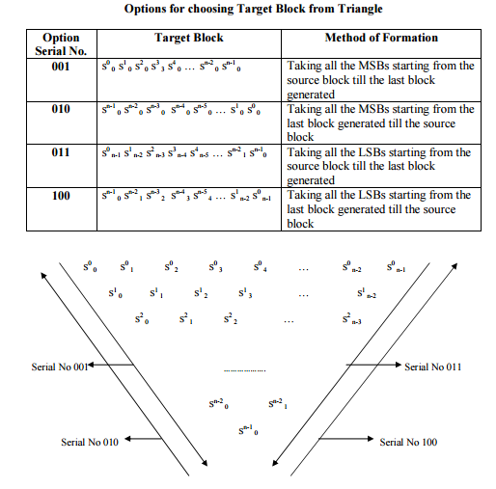
The corresponding figure shows a total of four option to form a target block from source block
Diagrammatic representation of options for choosing target block from triangle

Slide 8
IMPLEMENTATION
In this section; let us consider a plaintext : "Cryptography" Data Encryption to encrypt it using TE technique.
The corresponding stream of bits (S) is as follows :
01000011/01110010/01111001/01110000/01110100/01101111/01100111/01110010/01100001/01110000/01101000/01111001
Here "/" is used as the separator between successive bytes.
Now, generate triangular structure and choose random option to get the target block

Slide 9
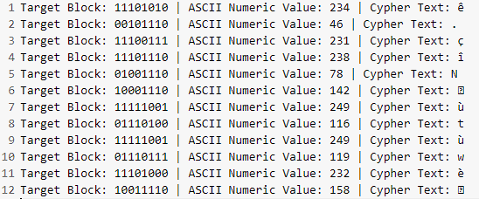
After implemented triangulation on randomly selected option we get the target block and according to it we convert them into ASCII and finally get the ciphertext.
Encrypted Cipher Text: ê.çîNùtùwè

Slide 10
DECRYPTION
The decryption process is a bit complicated. Here first we take the ciphertext and them them to ASCII character and again convert into 8 bit binary character and implement triangulation process each and every 8 bit binary blocks with options (001/011/010/100) to get the source blocks and then convert the source blocks into ASCII values and according to the ASCII character we just change them in to plain text character to get the actual massage. In this way we decrypt the actual massage.

Slide 11
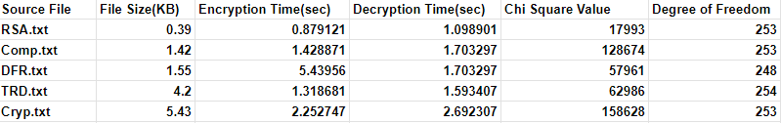
RESULT
This technique have been implemented to encryption and decrypt types of files such as .txt, .docs, .CPP, .SOIS, .exe, .DDN
Below table shown the result of encryption/decryption time , Chi square value, Degree of freedom for a txt file.

Slide 12
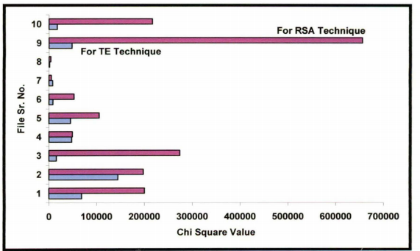
COMPARISON WITH RSA
Comparison between Proposed TE Technique and Existing RSA Technique

Slide 13
APPLICATION WORK
We will combine the TE technique with Session Key for encryption and decryption.
A session key is an encryption and decryption key that is randomly generated to ensure the security of a communications sessions between a user ans another computer or between two computers. Session key are sometimes called symmetric key because the same key used for both encryption and decryption.
The session key is only use only one session. It is then discarded and a new key is randomly generated for next session.

Slide 14
Proposal of Key Format
A 110-bit key format consisting of 11 different segments has been proposed For the segment of the rank R, there can exist a maximum of N = 2^{15-R} blocks, each of the unique size of S = 2^{15-R} bits, R starting from 1 and moving till 11.
For different values of R, following segments are generated:
∙ Segment with R=1 formed with the first maximum 16384 blocks, each of size 16384 bits;
∙ Segment with R=2 formed with the first maximum 8192 blocks, each of size 8192 bits;
∙ Segment with R=3 formed with the next maximum 4096 blocks, each of size 4096 bits;
∙ Segment with R=4 formed with the next maximum 2048 blocks, each of size 2048 bits;
∙ Segment with R=5 formed with the next maximum 1024 blocks, each of size 1024 bits;
∙ Segment with R=6 formed with the next maximum 512 blocks, each of size 512 bits;
∙ Segment with R=7 formed with the next maximum 256 blocks, each of size 256 bits;
∙ Segment with R=8 formed with the next maximum 128 blocks, each of size 128 bits;
∙ Segment with R=9 formed with the next maximum 64 blocks, each of size 64 bits;
∙ Segment with R=10 formed with the next maximum 32 blocks, each of size 32 bits;
∙ Segment with R=11 formed with the next maximum 16 blocks, each of size 16 bits;
With such a structure, the key space becomes of 110 bits long and a file of the maximum size of around 44.74 MB

Slide 15
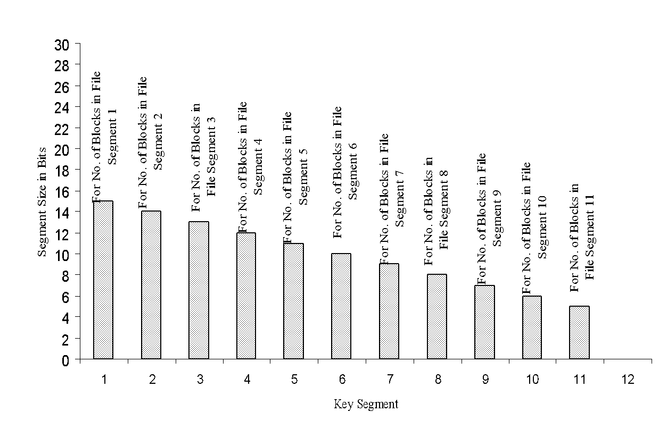
110-bit key format with 11 segments for RPMS Technique

Slide 16
Example of Key Generation-110 bit key
0 | 0 | 0 | 0 | 0 | 0 | 0 | 0 | 0 | 1 | 0 | 0 | 1 | 0 | 1
37 blocks/37bits
0 | 0 | 0 | 0 | 0 | 0 | 0 | 1 | 0 | 0 | 0 | 0 | 0 | 1
65 blocks/65bits
0 | 0 | 0 | 0 | 0 | 0 | 1 | 0 | 0 | 0 | 1 | 1 | 1
71 blocks/71bits
0 | 0 | 0 | 0 | 0 | 0 | 0 | 1 | 0 | 1 | 1 | 0
22 blocks/22bits
0 | 0 | 0 | 0 | 0 | 0 | 0 | 1 | 1 | 1 | 1
15 blocks/15bits
0 | 0 | 0 | 1 | 0 | 0 | 0 | 0 | 0 | 0
64 blocks/64bits
0 | 0 | 0 | 0 | 0 | 0 | 0 | 0 | 0
0 blocks/0bits
0 | 0 | 0 | 0 | 0 | 0 | 0 | 0
0 | 0 | 0 | 0 | 0 | 0 | 0
1 | 1 | 0 | 0 | 0 | 1
49 blocks/49bits
0 | 1 | 0 | 0 | 0
8 blocks/8bits
Total 37+65+71+22+15+64+49+8 blocks = 331 blocks

Slide 17
The Size of the file for this Session Key
Total 37+65+71+22+15+64+49+8 blocks = 331 blocks
and
37*37 + 65*65 + 71*71 + 22*22+ 15*15+ 64*64 + 49*49 + 8*8 = 17905 bits + 7 bits =17912 bits
=2239 bytes

Slide 18
CONCLUSION & FUTURE SCOPE
In conclusion, the Triangular Encryption (TE) technique offers a significant advancement over traditional methods like RSA, with its unique geometric transformations providing enhanced security and resistance to common cryptographic attacks. TE ensures data integrity and offers a versatile, scalable solution for various applications, making it a promising candidate for addressing evolving cyber threats. The future scope of TE is vast, including securing real-time voice communications, protecting images through encryption and digital watermarking, and ensuring the confidentiality of video content in streaming services and video conferencing. As research and development continue, TE is poised to become a standard in cryptographic practices, offering robust solutions for securely encrypting voice, images, and videos, thereby enhancing overall data security and privacy.

